Slide 1
INTRODUCTION OF TOOLBOX PROPERTIES IN VISUAL CODE
By,
PRANATHI K.S

Slide 2
PANEL
Panel creates a group of Controls. This Control provides a simple frame for putting sub-controls inside. These sub-Controls include Buttons and Textboxes. It further provides an optional border and ways to change its visibility.
SUB CONTROLS IN PANEL
The entire point of the panel is to provide a visual and logical grouping for controls. To add some controls to the panel, drag them to the inner part of the panel in Visual Studio

Slide 3
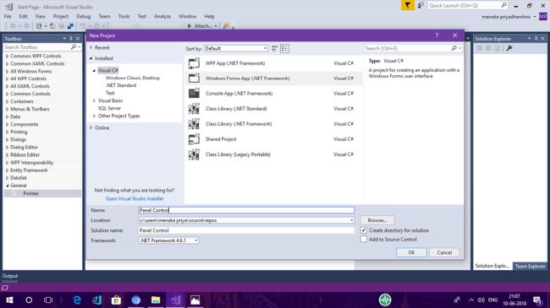
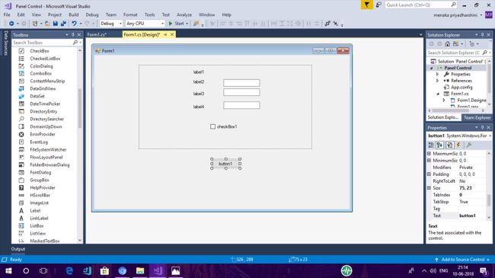
STEP 1 - Start the Project
Let's start the Project. Open Visual Studio 2017--->Start new Project--->Windows. Forms Application-->Name it as Panel Control
STEP 2 - Drag and Drop Controls
By Default Form Designer Page will be loaded and in the Designer page, You need to create three pages with the Panel Control. Page1:In the form drag and drop Panel control from the toolbox onto the form in Visual Studio 2017. Inside the Panel Control, drag and drop other sub controls like Label ,Textbox, and Checkbox. Change the text of the controls as given below in the screenshot.

Slide 4
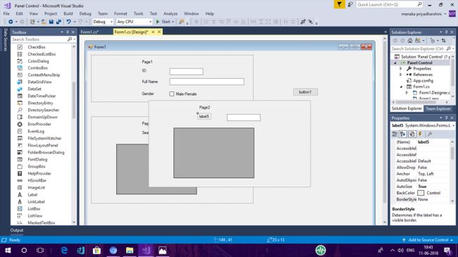
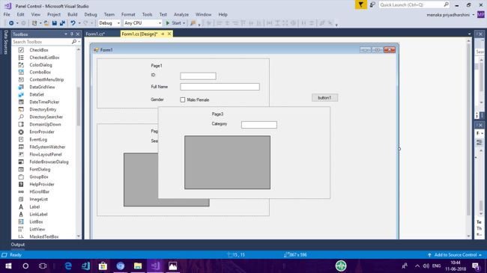
Page 2 In the form, drag and drop panel control from toolbox onto the form in Visual Studio 2017. Inside the Panel Control drag and drop other sub controls like Label, Textbox and Picture Box. Change the text of the controls as given below in the screenshot.
Page 3 In the form drag and drop panel control from the toolbox onto the form in Visual Studio 2017. Inside the Panel Control drag and drop other sub controls like Label, Textbox and Picture Box. Change the text of the controls as given below in the screenshot.

Slide 5
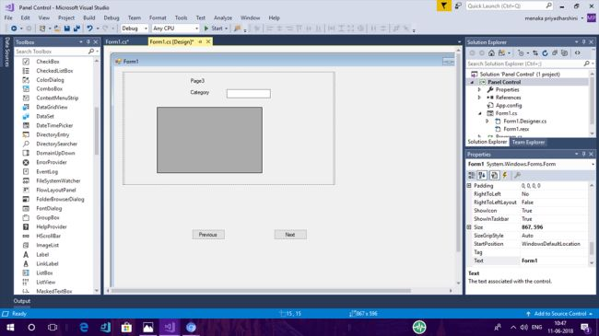
Drag and drop button control onto the form from toolbox in Visual Studio 2017 and change the text of the button as previous and next.

Slide 6
STEP 3 - Coding Follow the coding given below in the screenshot for panel control in the windows forms application.
private void button1_Click(object sender, EventArgs e)
{
if (index > 0)
listpanel[--index].BringToFront();
}
private void Form1_Load(object sender, EventArgs e)
{
listpanel.Add(panel1);
listpanel.Add(panel2);
listpanel.Add(panel3);
listpanel[index].BringToFront();
}
private void button2_Click(object sender, EventArgs e)
{
if (index < listpanel.Count - 1)
listpanel[++index].BringToFront();
}
STEP 4 - Output Compile and run the code and the following output wll be obtained as given below in the screenshot. As the next button is clicked pages are navigated to the next page. When the previous button is clicked the pages are navigated to the previous pages.

Slide 7
PERFORMANCE COUNTER
Performance counters are bits of code that monitor, count, or measure events in software, which allow us to see patterns from a high-level view. ... Therefore, performance counters can help measure key parts of the software.
FURTHER I WILL DEMONSTRATE THE SMALL FORM CODE EXAMPLE ON CPU USAGE OF MY PERSONAL SYSTEM

Slide 8
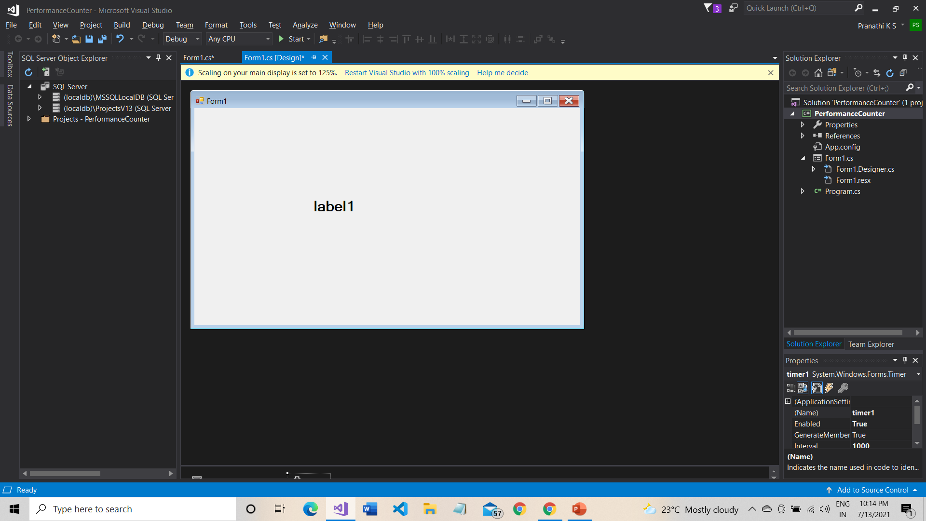
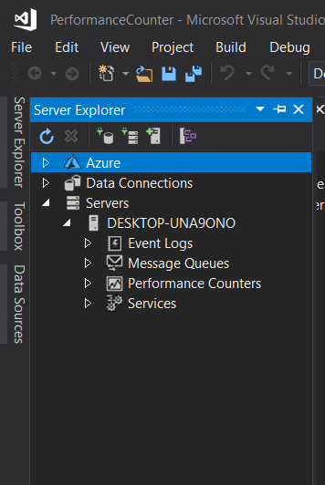
STEP 1 – Start the Project
Create a project and drag one label item from the toolbox.
STEP 2:
Click on view in the menu box . Select ---Server Explorer----in that go to servers db.-----Click on performance counter.

Slide 9
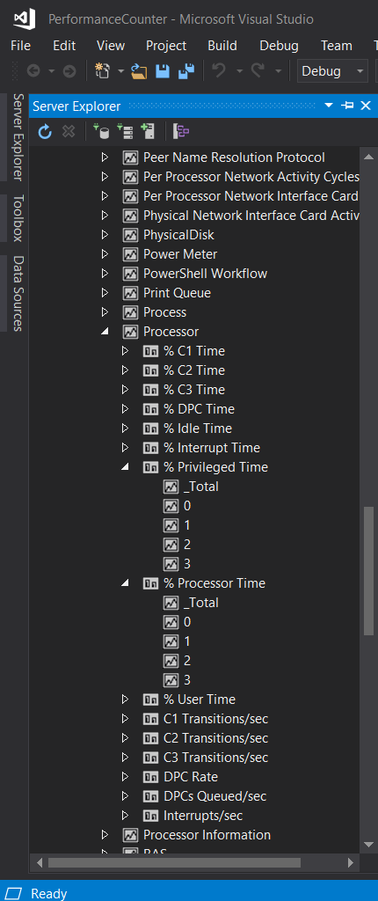
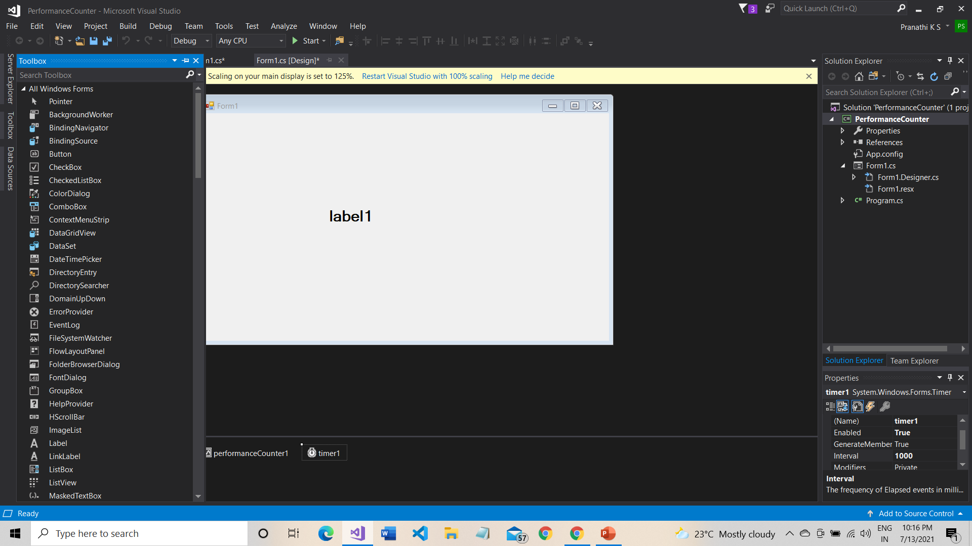
STEP 3:
Select processor.
STEP 4:
Drag and drop the performance counter and timer from the toolbox.

Slide 10
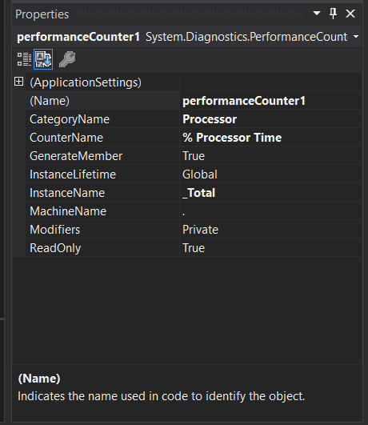
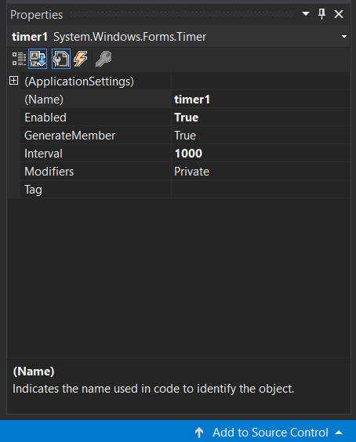
STEP 5:
After dragging the items change the properties of performance counter and timer as given below.

Slide 11
STEP 6: CODING PART
namespace PerformanceCounter
{
public partial class Form1 : Form
{
public Form1()
{
InitializeComponent();
}
private void label1_Click(object sender, EventArgs e)
{
label1.Text ="CPU usage: " + performanceCounter1.NextValue();
}
private void Form1_Load(object sender, EventArgs e)
{
}
}
}

Slide 12
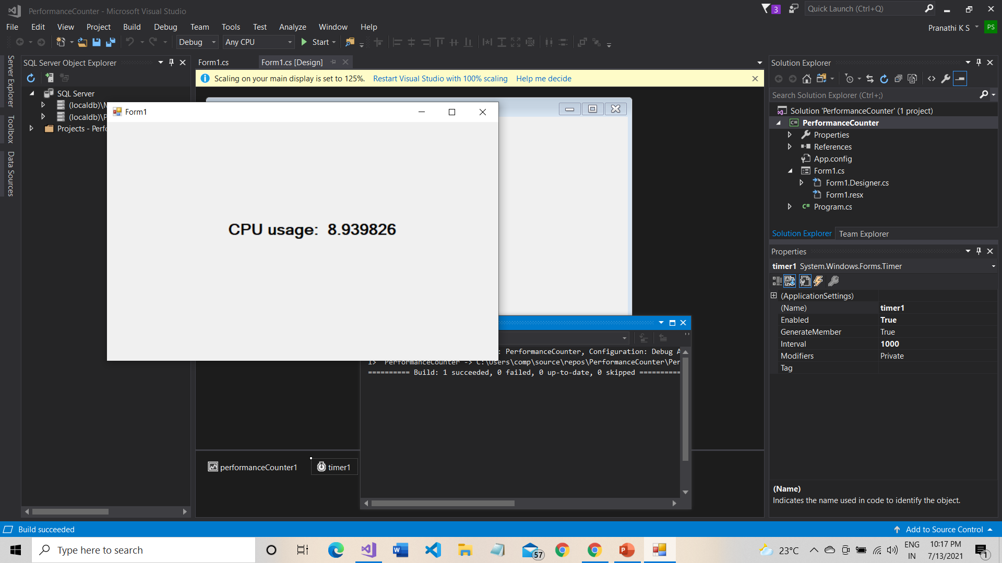
STEP 6: OUTPUT
Compile and Run the Code.

Slide 13
THANK YOU

